Slide 1
Analysis and Prediction of Crime in India
Tanya Gautam(MTech. CSE)
Ekta Tank(MTech. CSE)
Sujay Raj(MTech. CSE)

Slide 2
Problem Statement
Extraction of crime patterns by crime analysis in different states of India from 2001-2011.
Based on the analysis, predicting the crime status of a state for upcoming years using various classification techniques.

Slide 3
Data Used
“Crime in India” from Kaggle.com
The dataset consists of state-wise and district-wise database of different IPC crimes based on the frequencies of those crimes between the years 2001 and 2012.

Slide 4
Data Preprocessing
Data Cleaning
Feature Selection
Division of all crime frequencies by the total number of IPC crimes
Min-Max Scaling
Applying our self-defined weights to the features (Biasing)

Slide 5
Clustering and Classification
Clustering : K-Means with 3 centroids
The clusters obtained were labeled as 'Relatively dangerous', 'Moderate' and 'Safe’.
Cluster Validation was done using the Silhouette Coefficient.
Classification : KNN Classifier with K=1
The data of all states for all years with the labels obtained by clustering is used as training data for the classifier.
Classification Validation was done using the 10-Fold cross validation

Slide 6
Results and Observations
Our findings show that the frequency of more severe crimes is relatively low in the Western and Southern states and Union Territories of India.
States like Gujarat, Himachal Pradesh, Lakshadweep have consistently been the ‘Safe’ states throughout our analysis.
States like ‘Nagaland’, ‘Meghalaya’, ‘Mizoram’ have consistently been ‘Dangerous’ states from 2001 to 2012.
Sikkim has transitioned from a ‘Safe’ state to ‘Dangerous’ state in the subsequent years.

Slide 7
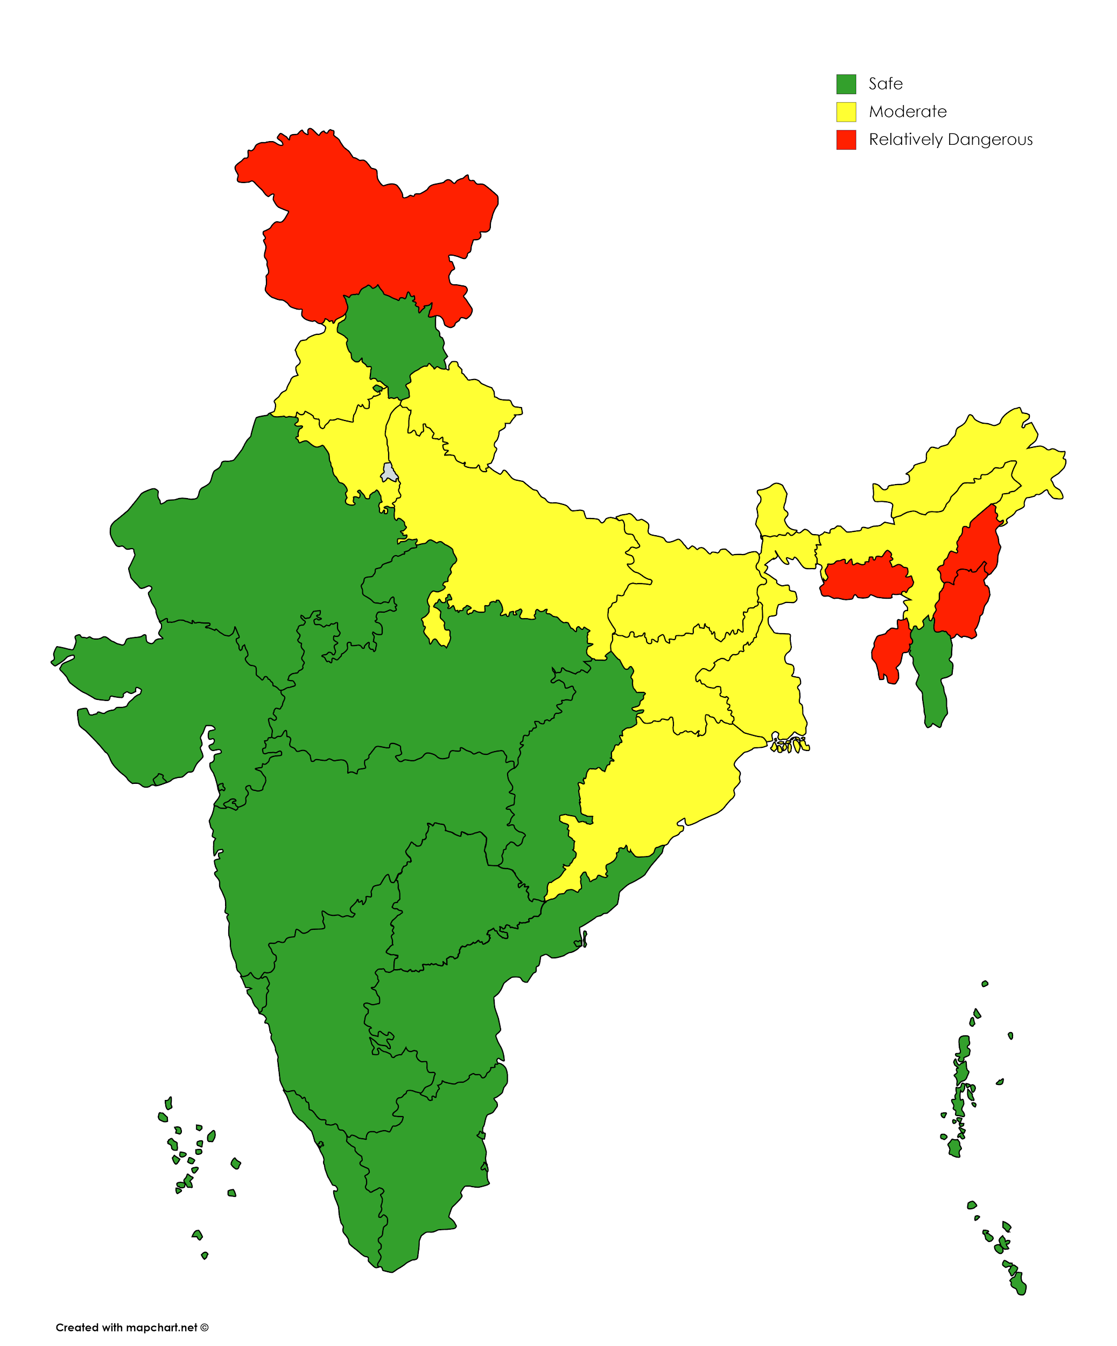
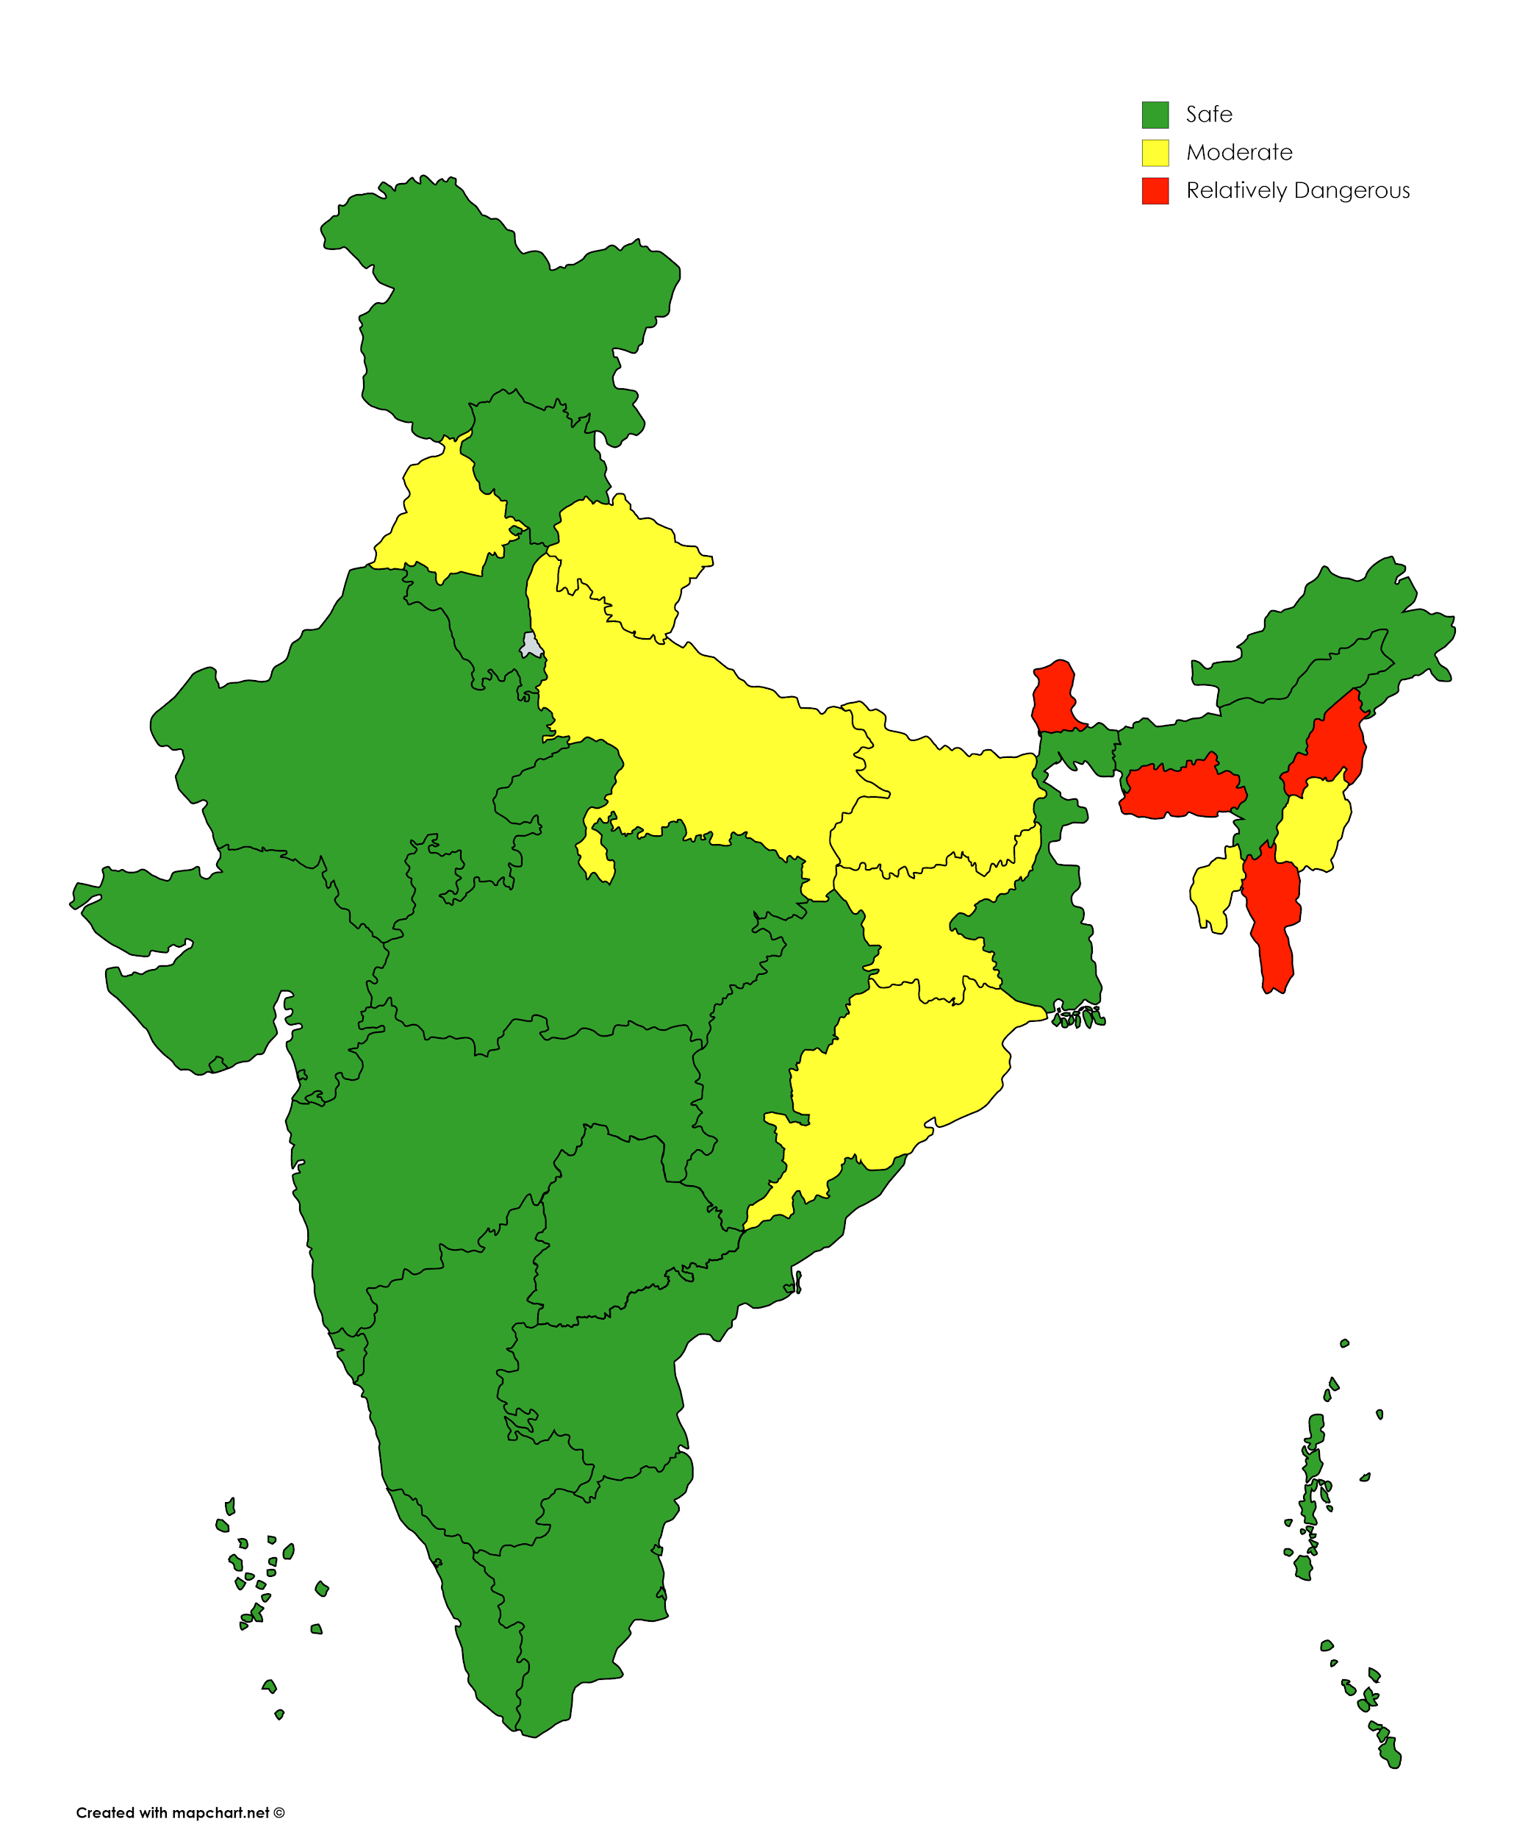
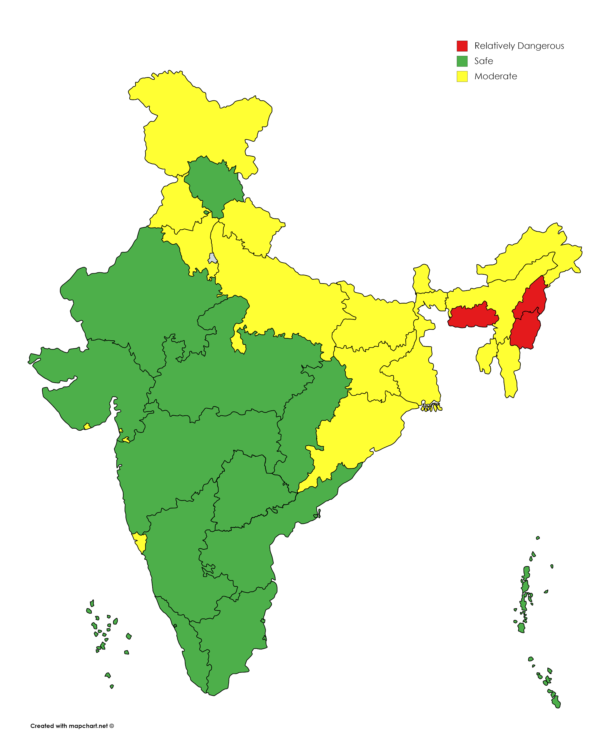
Fig.1. Crime scenario of India Fig.2. Crime Scenario of India in Fig.3. Crime Scenario of India in 2001 in 2012 in average from 2001 to 2012

Slide 8
Accuracies Obtained
The overall average Silhouette co-efficient of cluster validation is 0.2269.
The classification accuracy reported by 10-Fold validation is 88.23%

Slide 9


